Slide 1
House-Hold Smart Share
Project Supervisor:
Md. Monowar Hossain
Assistant Professor
Department of CSE,BSMRSTU
Gopalganj-8100.
Submitted By:
Md. Imran Hosen
Student ID: 18CSE019
Department of CSE,BSMRSTU
Gopalganj-8100.

Slide 2
Outline
Introduction
Motivation
About the Application
Features and Result
Implementation
Future scope of the program
Conclusions

Slide 3
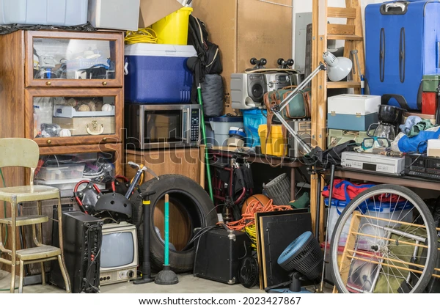
Introduction
Our old things do not turn into dirt and are useful for someone else to use. So that people benefit using this web application.

Slide 4
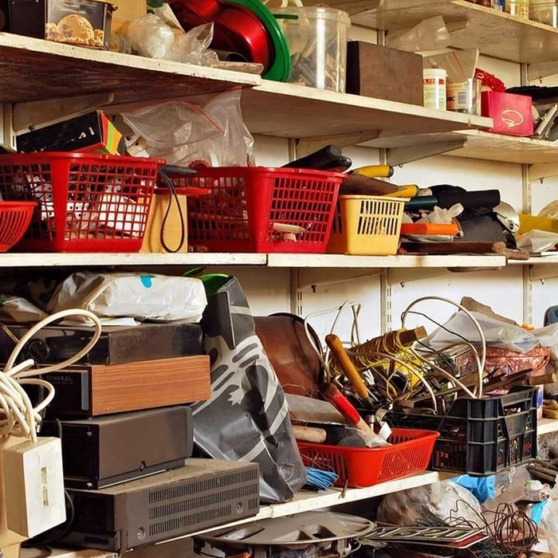
Motivation
We have so many things around us that we don't use them. I am motivated to see, how these item can be used.

Slide 5
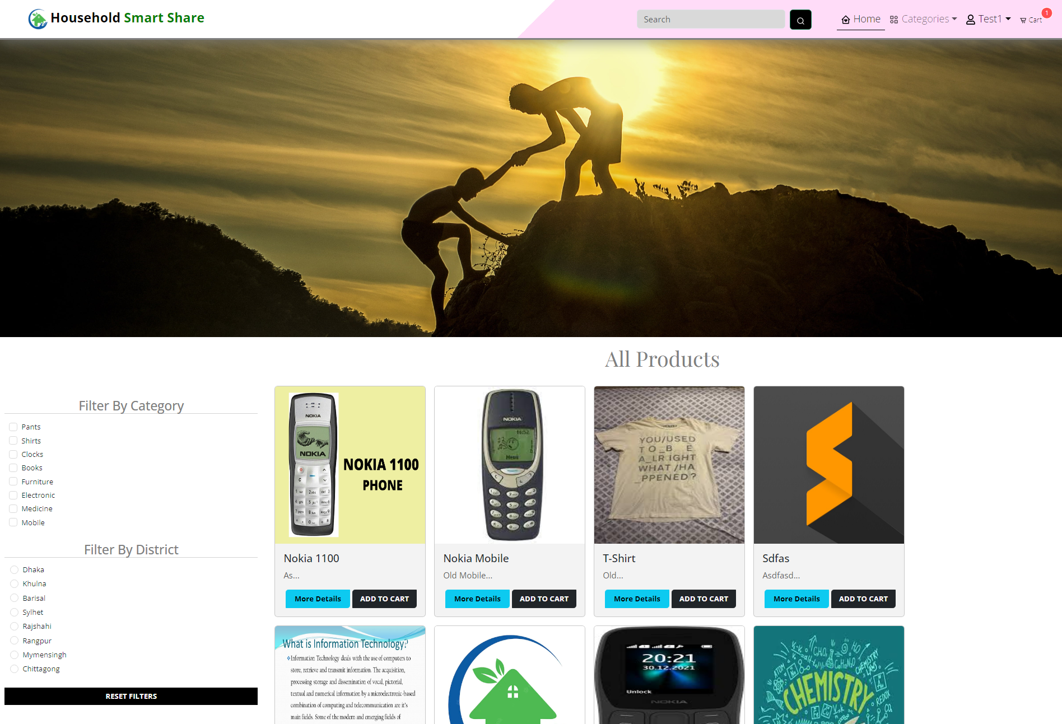
About The application
We made this application where people can upload unused items in this application. Those who need these items can request through this application.

Slide 6
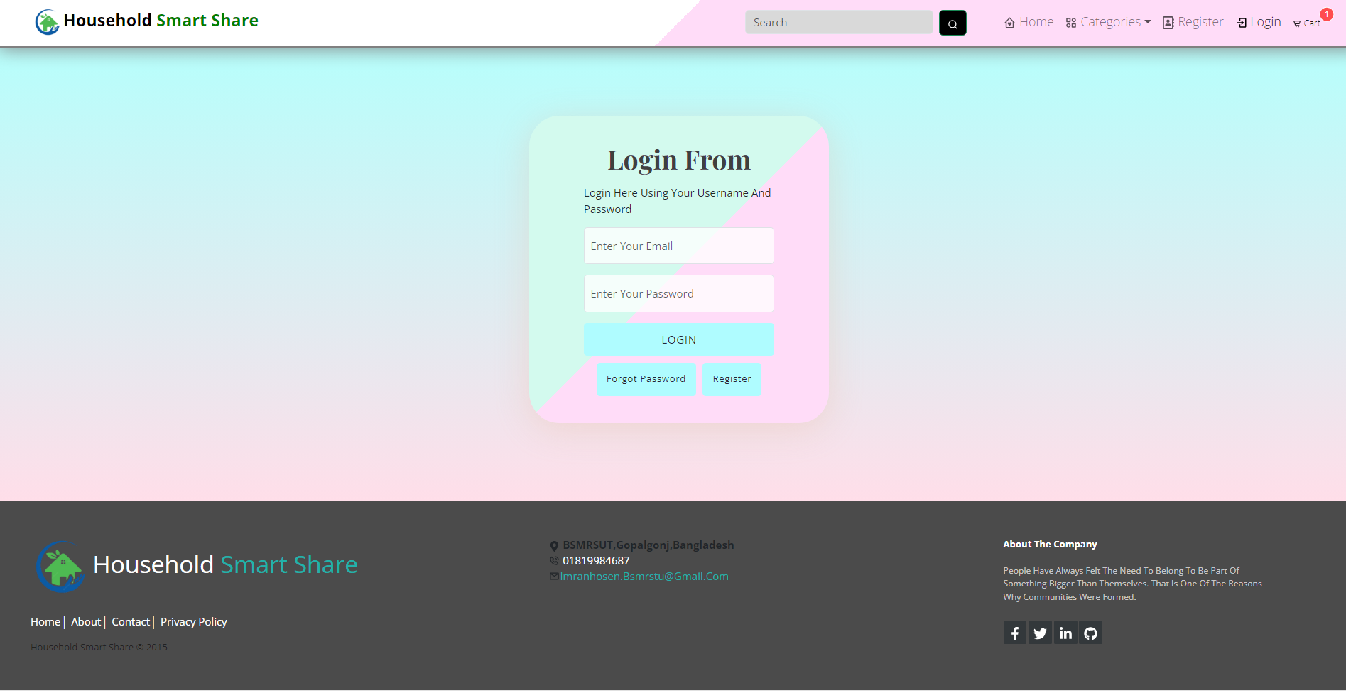
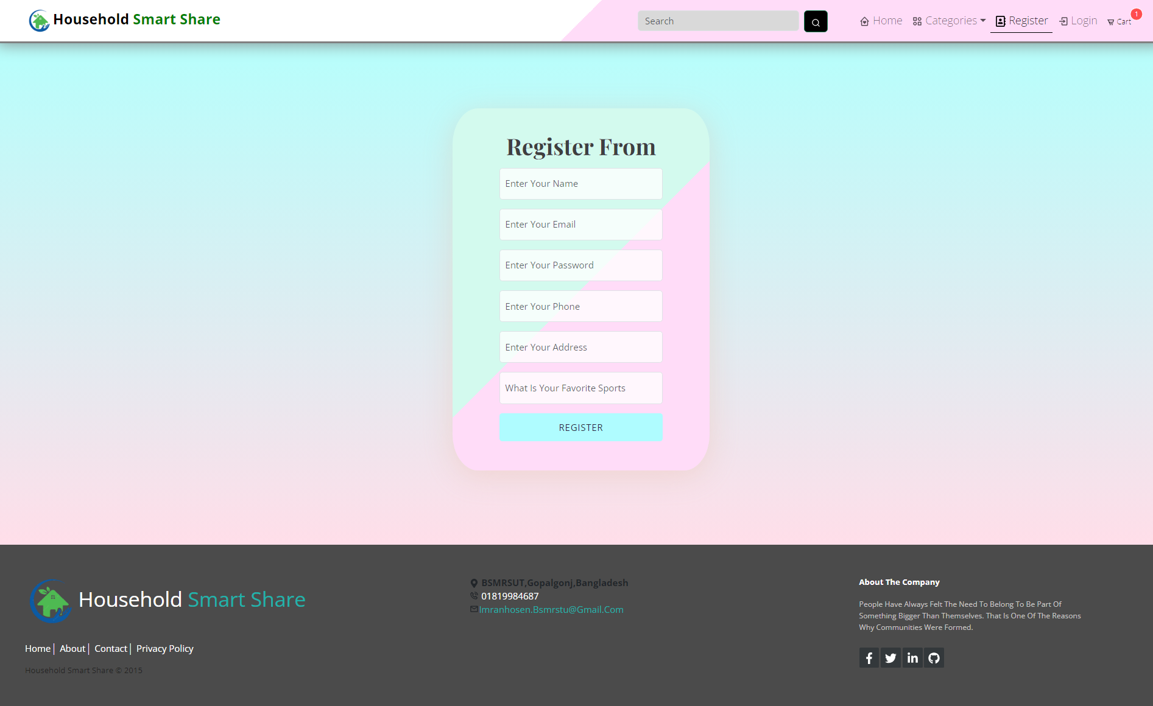
Features of Application
Login, Registration
User panel
Divide item in category
Search and filter Item
Product View
Update and delete item

Slide 7
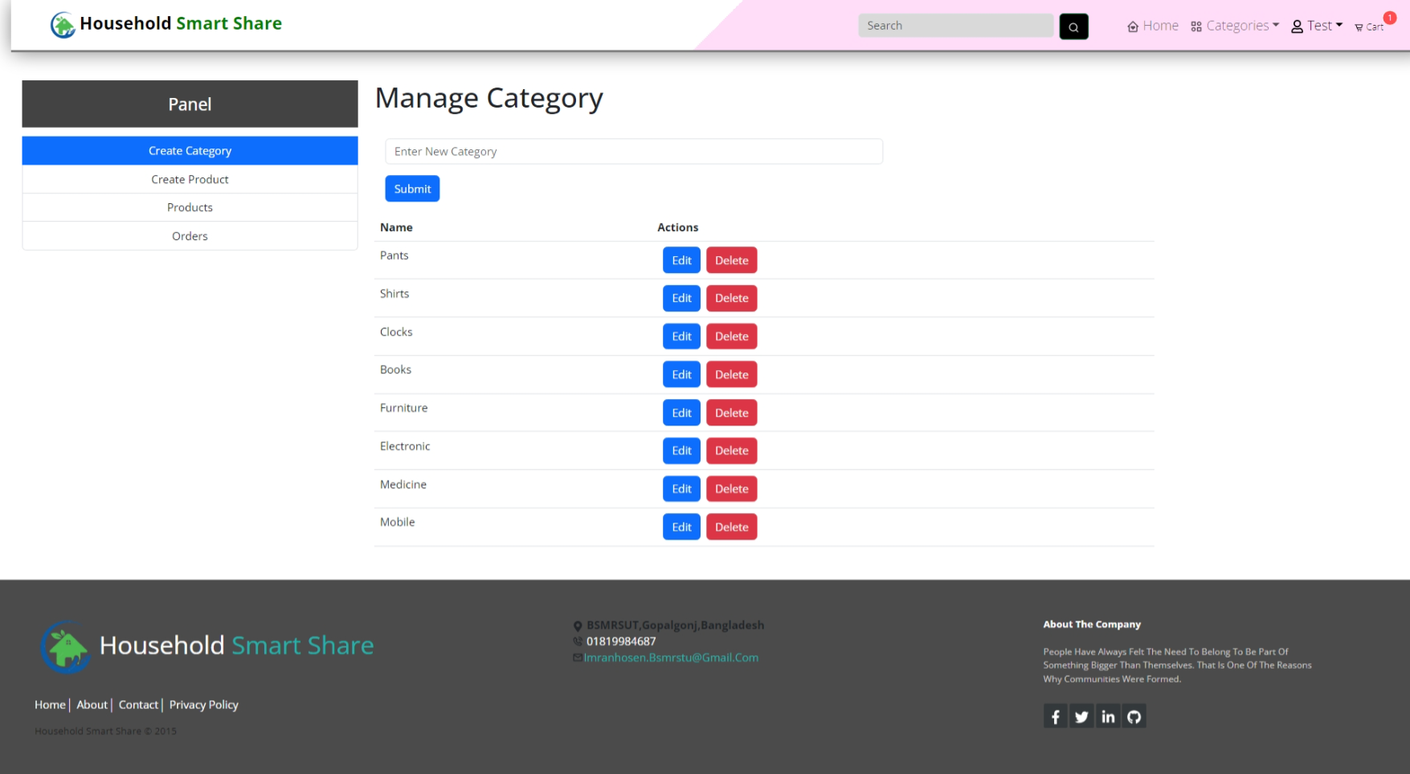
User panel
Create category
Create product
Update product list
Order list

Slide 8
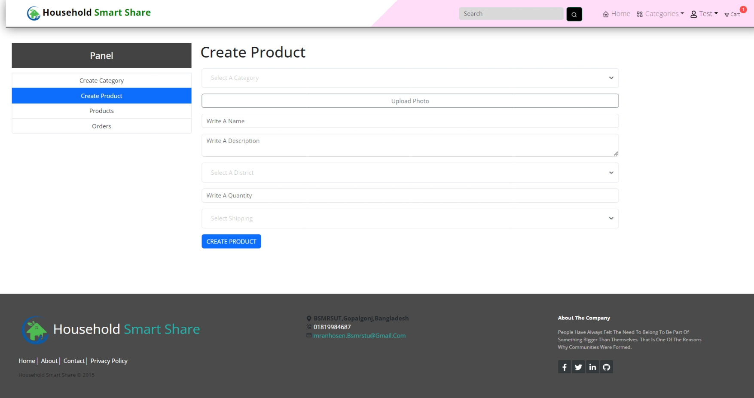
User panel
Create category
Create product
Update product list
Order list

Slide 9
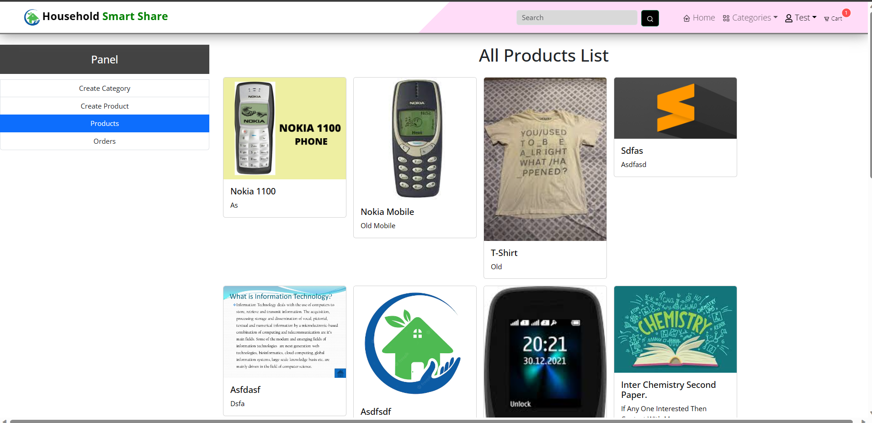
User panel
Create category
Create product
Update product list
Order list

Slide 10
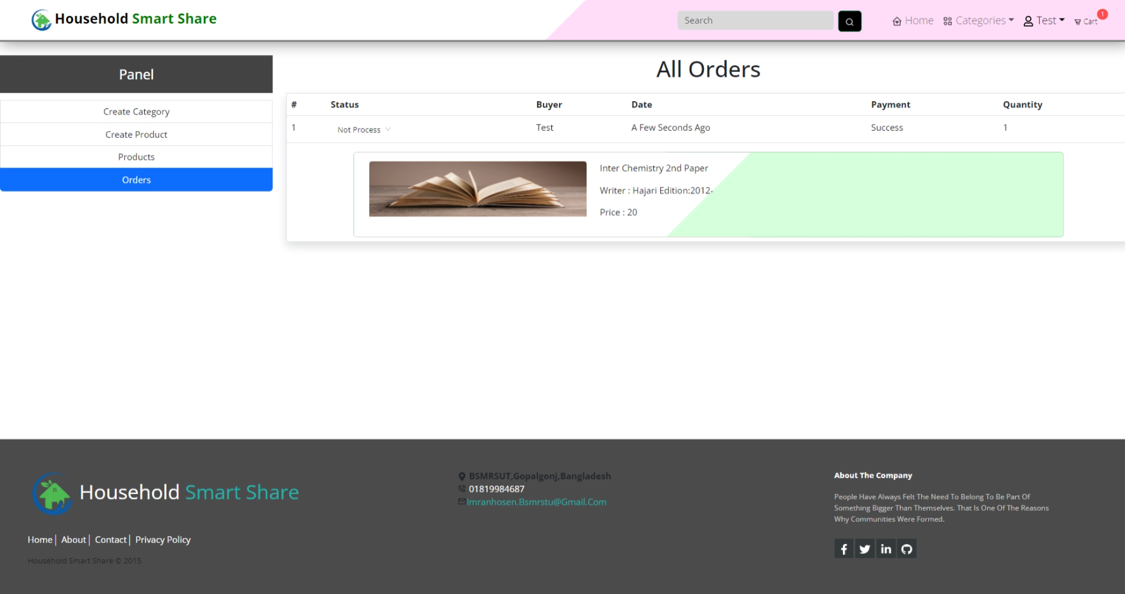
User panel
Create category
Create product
Update product list
Order list

Slide 11
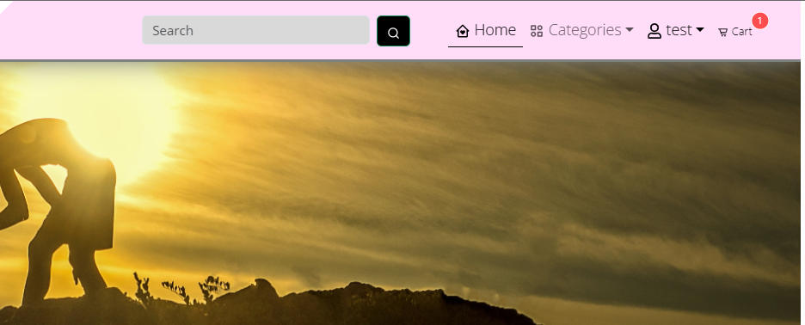
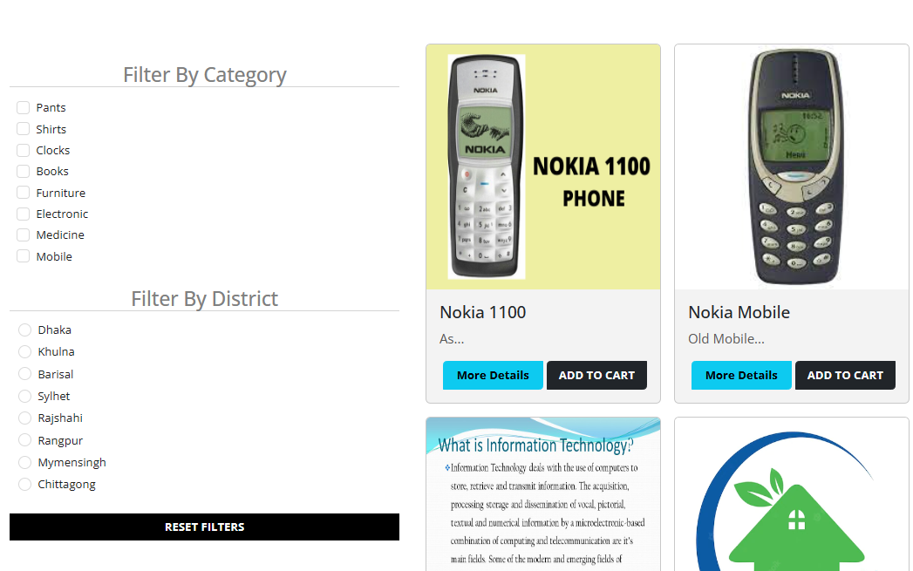

Search Item and Filter
Search item by name
Filter by category
Filter by location

Slide 12
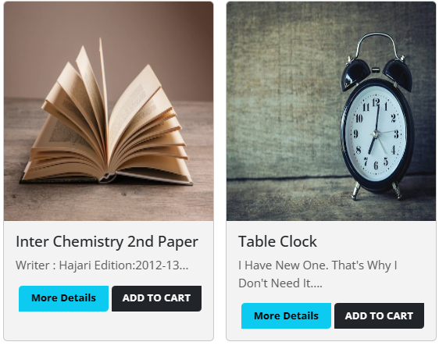
Product View
More details
Add to cart

Slide 13
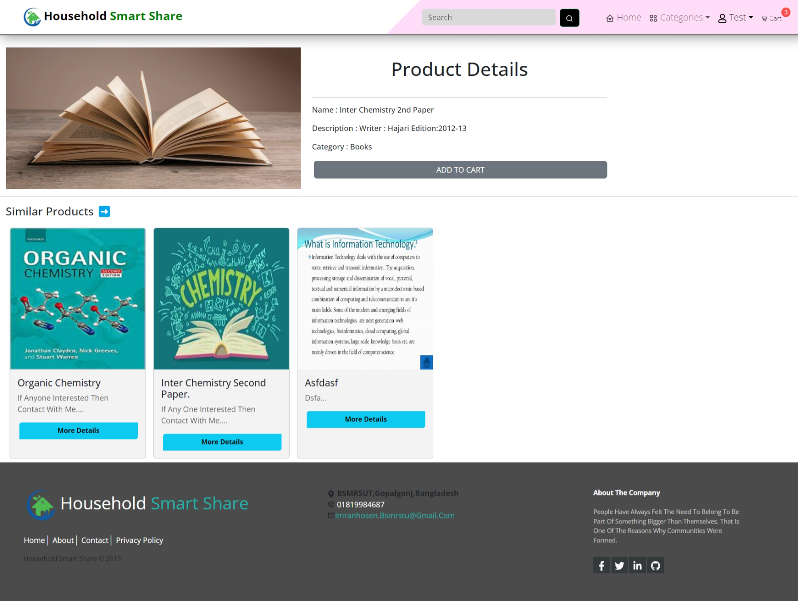
Product View
More details
Add to cart

Slide 14
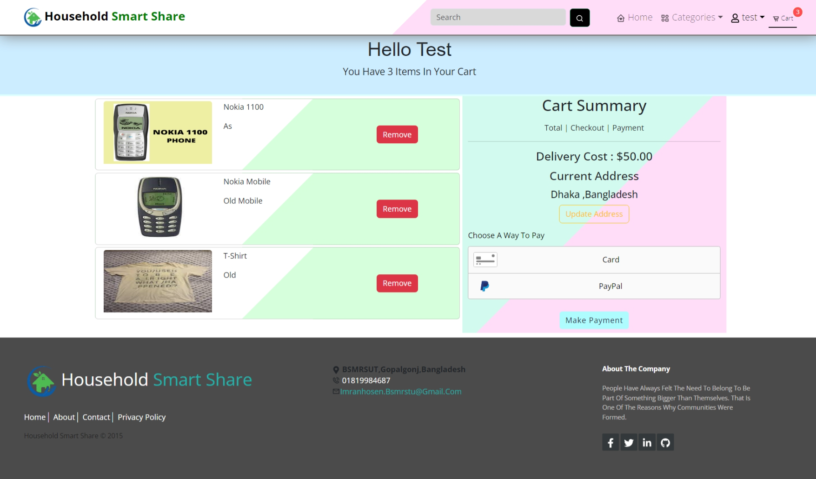
Product View
More details
Add to cart

Slide 15
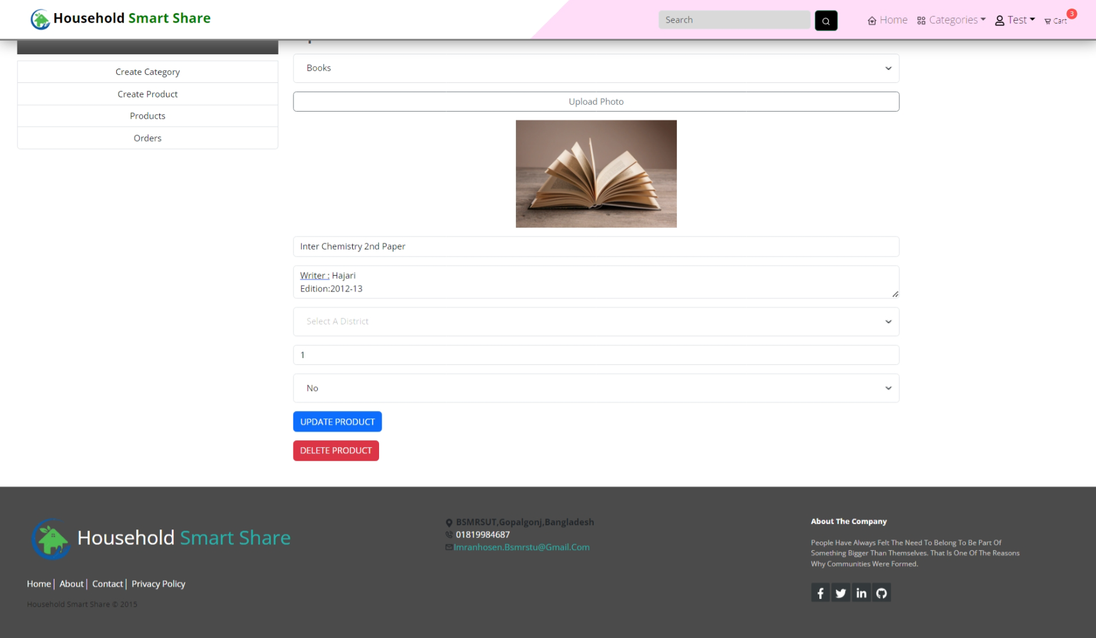
Update and delete item
Update item
Delete item

Slide 16






IMPLEMENTATION
Visual Studio Code
Javascript
HTML,CSS
Mongodb
Nodejs
Git

Slide 17
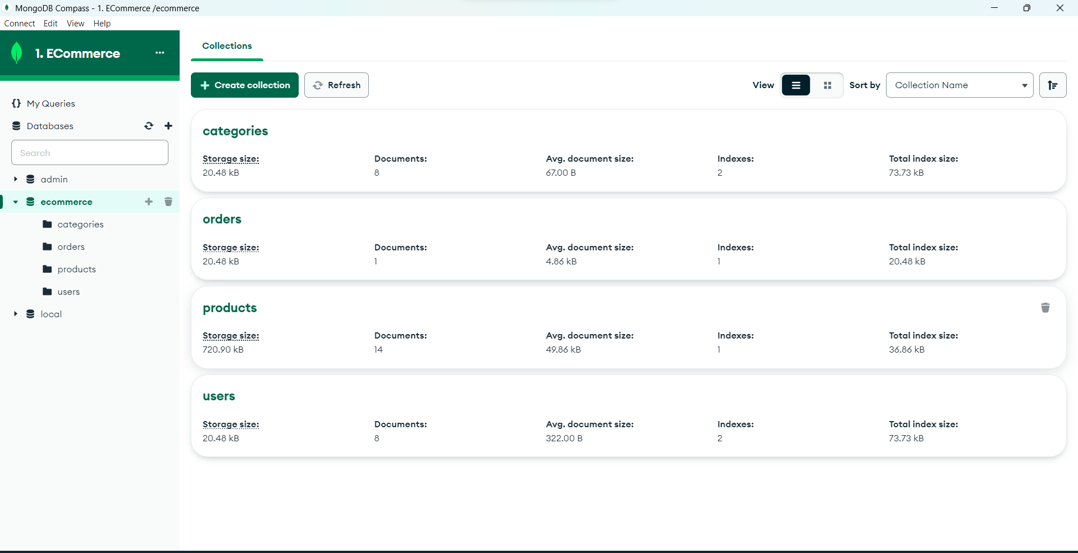
Database-Mongodb
Categories
Order
Products
Users

Slide 18
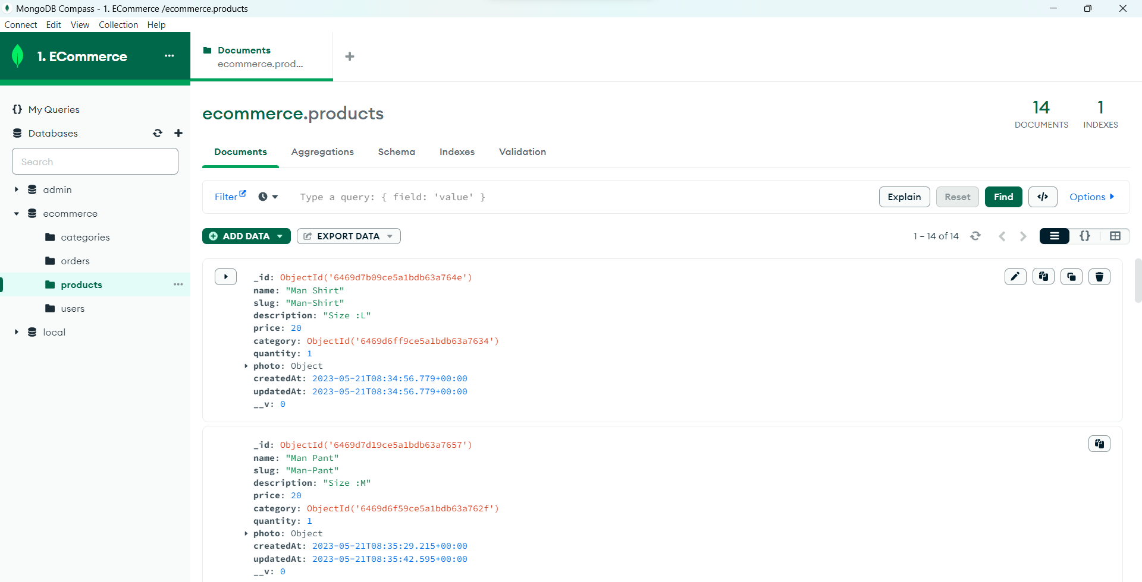
Database-Mongodb
Categories
Order
Products
Users

Slide 19
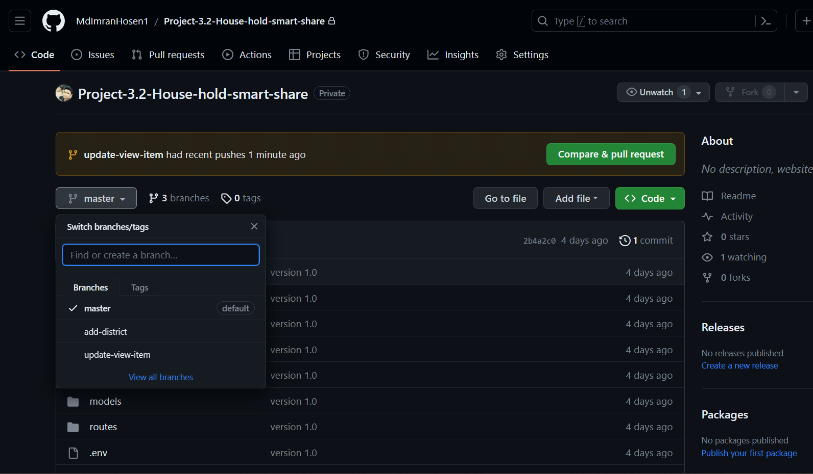
Git
Version Control

Slide 20
Future scope of the program
Add google map for searching
Add chat system
More friendly Interface
More security

Slide 21
Conclusions
This web application will help people to used an unused item.

Slide 22
THANKS!

